Slide 1
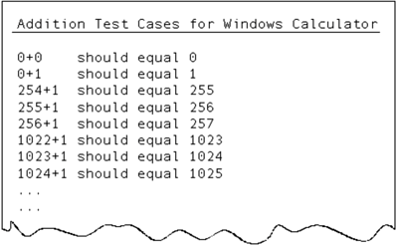
1. Dynamic Black-Box Testing: Testing the Software While Blindfolded

Slide 2
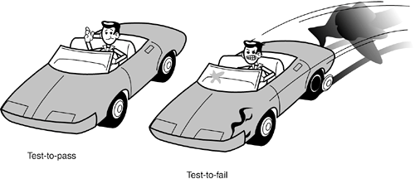
2. Test-to-Pass and Test-to-Fail

Slide 3
3. Equivalence Partitioning

Slide 4
4. Data Testing
  Boundary Conditions
    Types of Boundary Conditions
    Testing the Boundary Edges
  Sub-Boundary Conditions
    Powers-of-Two
    ASCII Table
  Default, Empty, Blank, Null, Zero, and None
  Invalid, Wrong, Incorrect, and Garbage Data

Slide 5
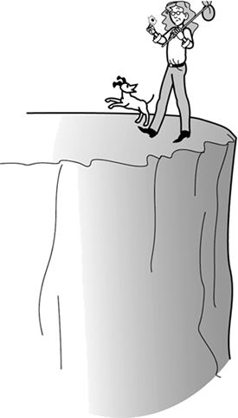
4. Data Testing
  Boundary Conditions

Slide 6
4. Data Testing
  Types of Boundary Conditions

Slide 7
4. Data Testing
  Testing the Boundary Edges

Slide 8
4. Data Testing
  Sub-Boundary Conditions

Slide 9
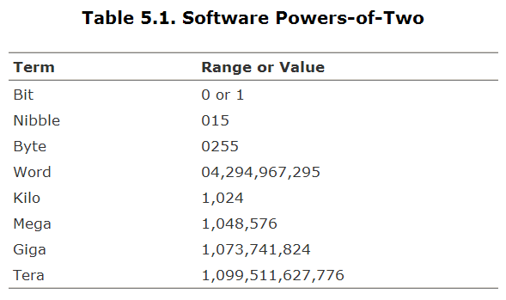
4. Data Testing
  Powers-of-Two

Slide 10
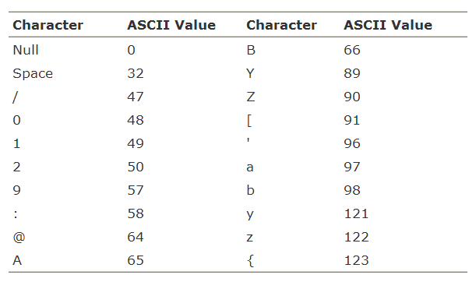
4. Data Testing
  ASCII Table

Slide 11
4. Data Testing
  Default, Empty, Blank, Null, Zero, and None

Slide 12
4. Data Testing
  Invalid, Wrong, Incorrect, and Garbage Data

Slide 13
4. Data Testing
  Boundary Conditions
    Types of Boundary Conditions
    Testing the Boundary Edges
  Sub-Boundary Conditions
    Powers-of-Two
    ASCII Table
  Default, Empty, Blank, Null, Zero, and None
  Invalid, Wrong, Incorrect, and Garbage Data

Slide 14
5. State Testing
  Testing the Software's Logic Flow
  Creating a State Transition Map
  Reducing the Number of States and Transitions to Test
  What to Specifically Test
  Testing States to Fail
    Race Conditions and Bad Timing
    Repetition, Stress, and Load

Slide 15
5. State Testing
  Testing the Software's Logic Flow

Slide 16
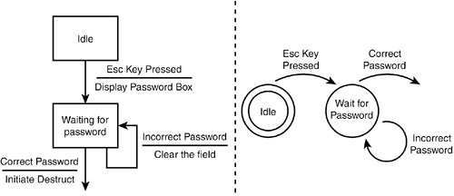
5. State Testing
  Creating a State Transition Map

Slide 17
5. State Testing
  Reducing the Number of States and Transitions to Test
    Visit each state at least once.
    Test the state-to-state transitions that look like the most common or popular.
    Test the least common paths between states.
    Test all the error states and returning from the error states.
    Test random state transitions.

Slide 18
5. State Testing
  What to Specifically Test

Slide 19
5. State Testing
  Testing States to Fail

Slide 20
5. State Testing
  Race Conditions and Bad Timing

Slide 21
5. State Testing
  Repetition, Stress, and Load

Slide 22
5. State Testing
  Testing the Software's Logic Flow
  Creating a State Transition Map
  Reducing the Number of States and Transitions to Test
  What to Specifically Test
  Testing States to Fail
    Race Conditions and Bad Timing
    Repetition, Stress, and Load

Slide 23
6. Other Black-Box Test Techniques
  Behave Like a Dumb User
  Look for Bugs Where You've Already Found Them
  Think like a Hacker
  Follow Experience, Intuition, and Hunches

Slide 24
6. Other Black-Box Test Techniques
  Behave Like a Dumb User

Slide 25
6. Other Black-Box Test Techniques
  Look for Bugs Where You've Already Found Them

Slide 26
6. Other Black-Box Test Techniques
  Think like a Hacker

Slide 27
6. Other Black-Box Test Techniques
  Follow Experience, Intuition, and Hunches

Slide 28
6. Other Black-Box Test Techniques
  Behave Like a Dumb User
  Look for Bugs Where You've Already Found Them
  Think like a Hacker
  Follow Experience, Intuition, and Hunches

Slide 29
1. Dynamic Black-Box Testing: Testing the Software While Blindfolded
2. Test-to-Pass and Test-to-Fail
3. Equivalence Partitioning
4. Data Testing
5. State Testing
6. Other Black-Box Test Techniques

Slide 30
Task:
1. Test a Software

Slide 31
1. Static White-Box Testing: Examining the Design and Code

Slide 32
2. Formal Reviews

Slide 33
3. Coding Standards and Guidelines

Slide 34
4. Generic Code Review Checklist

Slide 35
1. Static White-Box Testing: Examining the Design and Code
2. Formal Reviews
3. Coding Standards and Guidelines
4. Generic Code Review Checklist

Slide 36
Quiz:

